Slide 1
Fill the following table in your books
What I already know about chemistry | What I want to know about chemistry | What I learned about chemistry this class

Slide 2
Atomic structure

Slide 3
Aims
Learning objectives:
We will learn about the periodic table and describing atomic structure
Success criteria:
We will be able to determine the number of protons, neutrons, and electrons in an element
We will be able to draw the structure of an atom

Slide 4
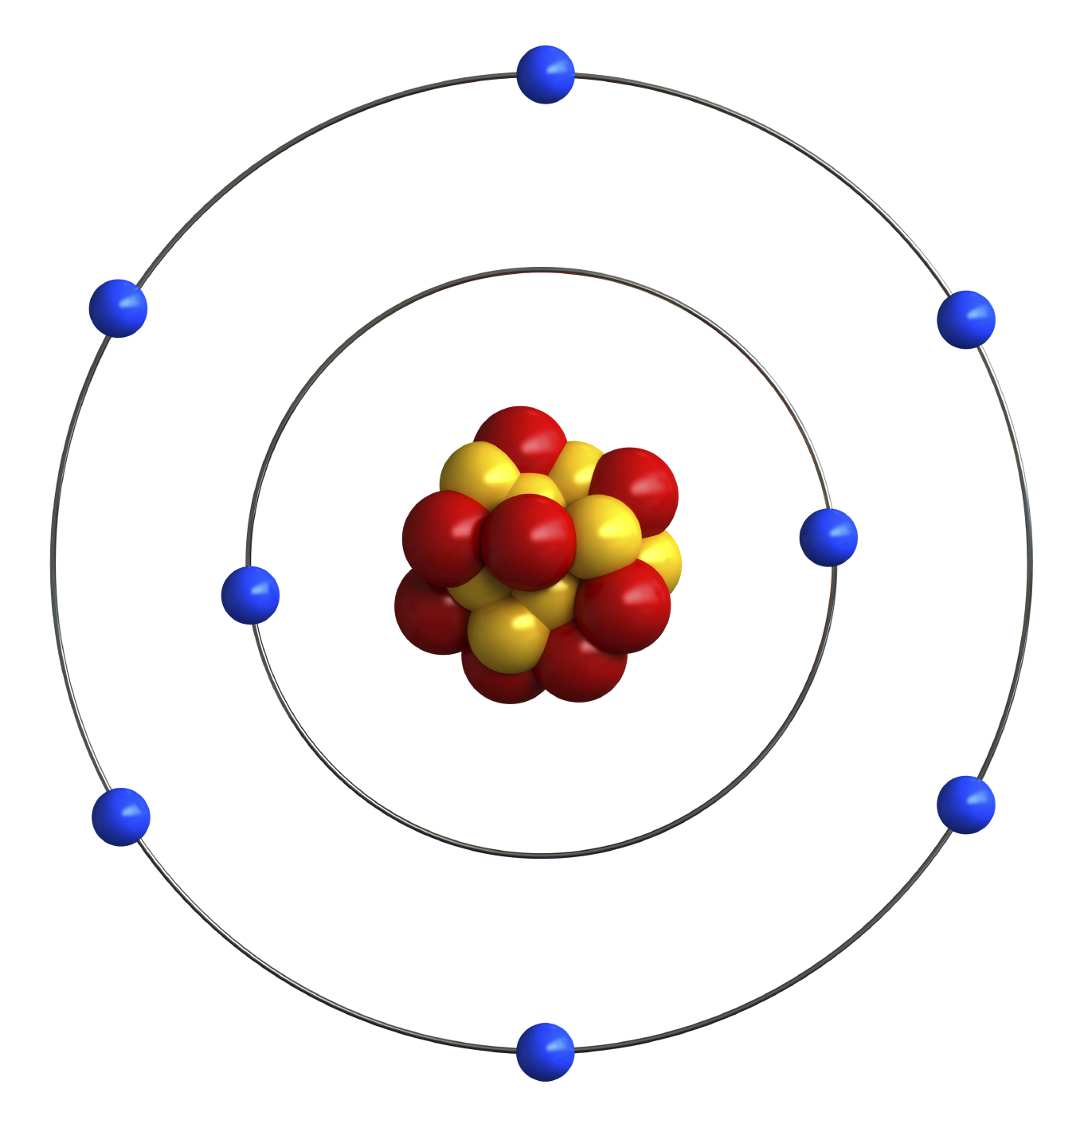
atoms
An atom is made up of three sub-atomic particles – protons, neutrons, and electrons
These particles exist in one of two places:
The nucleus (the centre of the atom)
The electron shells (the rings around the atom)
Protons and neutrons are both found in the nucleus
Electrons are found in the electron shell

Slide 5
Sub-atomic particles
The following table lists the mass and charge of each sub-atomic particle:
What type of element or atom depends entirely on the number of protons in that atom. For example, hydrogen will always have 1 proton, helium will always have 2 protons, lithium will always have 3 protons, etc.
We can determine the amount of protons, neutrons, and electrons an element has by looking at the periodic table
 | Protons | Neutrons | Electrons
Charge | +1 | 0 | -1
Relative Mass | 1 | 1 | About 1/2000

Slide 6

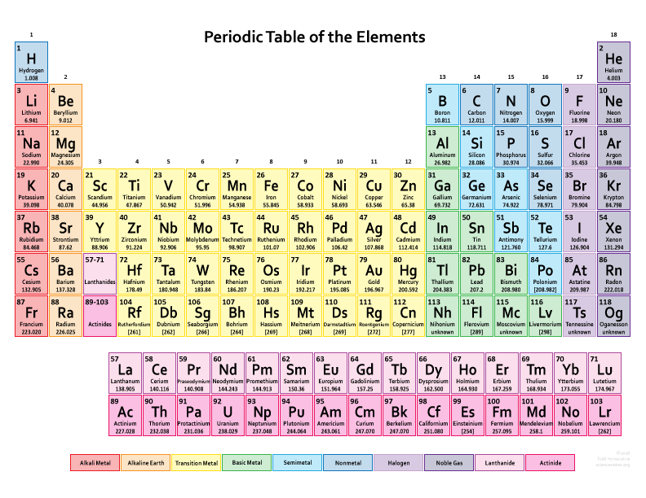
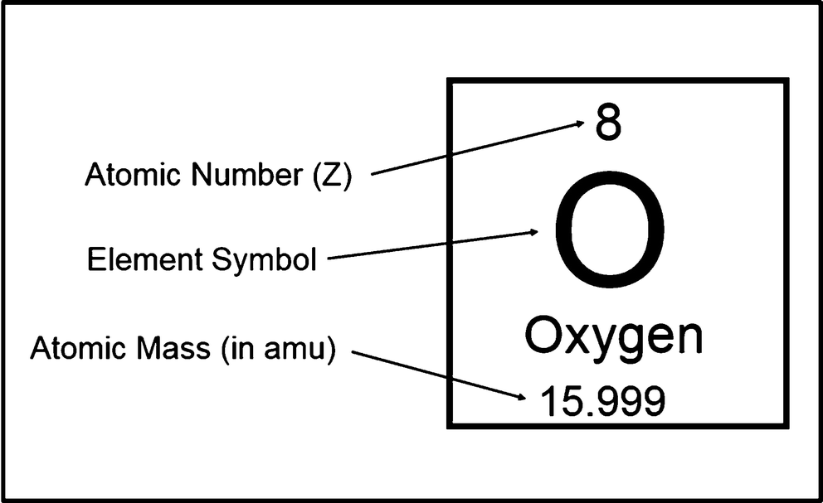
Periodic Table
Arranged in the order of how many protons each element has. This is called the “atomic number”

Slide 7
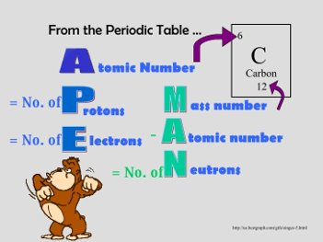
Number of sub-atomic particles
The number of protons is given by the atomic number
In an uncharged atom, the number of electrons is equal to the number of protons (also the atomic numbers
The number of neutrons is the atomic mass minus the atomic number

Slide 8

guided practice
Over the next 5 minutes, fill in this table using the supplied periodic table
Element | Atomic Number | Mass Number | Number of protons | Number of neutrons | Number of electrons
Hydrogen
Oxygen
Calcium
Gold
End

Slide 9
Electron arrangements
Each electron shell can hold a different amount of electrons:
First shell: 2
Second shell: 8
Third shell: 18
Fourth shell: 32
These shells also have a letter that represents them:
First shell: K
Second shell: L
Third shell: M
Fourth shell: N

Slide 10
Electron configuration
Sometimes, we like to write the electron arrangement as a series of numbers – this is called the electron configuration. For example, the electron configuration for sodium (atomic number = 11) is 2, 8, 1
To figure this out for the first 20 elements, we use the “2-8-8-2” rule. This says that the first shell stops accepting electrons after it has 2, the second stops when it has 8, the third also stops when it has 8, and the fourth stops when it has 2 as well.
Oxygen (atomic number=8): 2, 6
Potassium (atomic number=19): 2, 8, 8, 1
Sulfur (atomic number=16): 2, 8, 6

Slide 11
Electron configuration method
Step 1: Count the number of electrons
Step 2: Add electrons to the first shell until you run out or it is full (2)
Step 3: Add electrons to the second shell until you run out or it is full (8)
Step 4: Add electrons to the third shell until you run out or it is full (8)
Step 5: Add electrons to the fourth shell until you run out or it is full (2)
For example, let’s work through phosphorus (atomic number=15)

Slide 12
Guided practice
Figure out the electron configuration for the following:
Beryllium (atomic number=4)
Fluorine (atomic number=9)
Aluminium (atomic number=13)
Calcium (atomic number=20)
End

Slide 13
Independent practice
Complete the following table:
Draw a picture of boron
Element | Atomic Number | Mass Number | Number of protons | Number of neutrons | Number of electrons | Electron Configuration
Boron
 | 12
 |  | 14
 |  |  | 18

Slide 14
Aims
Learning objectives:
We will learn about the periodic table and describing atomic structure
Success criteria:
We will be able to determine the number of protons, neutrons, and electrons in an element
We will be able to draw the structure of an atom

